Slide 1
Extending the Shuffle Model of Differential Privacy to Vectors
Mary Scott
Joint work (in progress) with
Graham Cormode and Carsten Maple

Slide 2
Research Motivation
My research area is Privacy-Enhancing Technologies (PETs), with a particular focus on Differential Privacy (DP).
DP is a strong, mathematical definition of privacy in the context of statistical and machine learning analysis.
Provides mathematically provable guarantee of privacy protection against wide range of privacy attacks.
Ensures that any given disclosure is within a small multiplicative factor, whether or not an individual participates in the dataset.

Slide 3
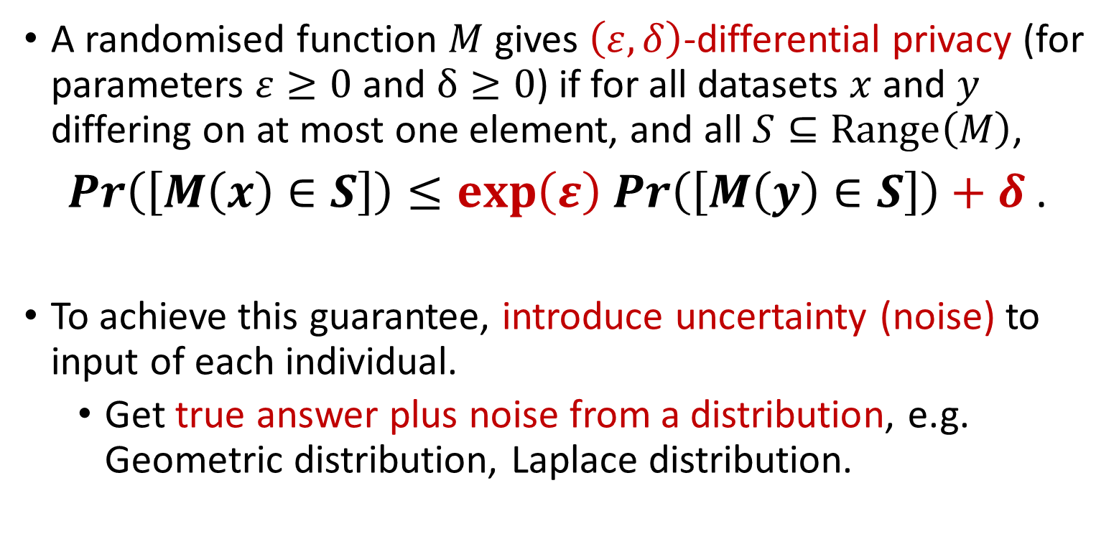
Research Motivation
A randomised function $M$ gives $\left(ε,δ\right)$-differential privacy (for parameters $ε≥0$ and $δ≥0$) if for all datasets $x$ and $y$ differing on at most one element, and all $S⊆Range\left(M\right)$,
$\operatorname{Pr}\left(\left[M\left(x\right)∈S\right]\right)≤\exp\left(ε\right)$ $\operatorname{Pr}\left(\left[M\left(y\right)∈S\right]\right)+δ$ .
To achieve this guarantee, introduce uncertainty (noise) to input of each individual.
Get true answer plus noise from a distribution, e.g. Geometric distribution, Laplace distribution.

Slide 4
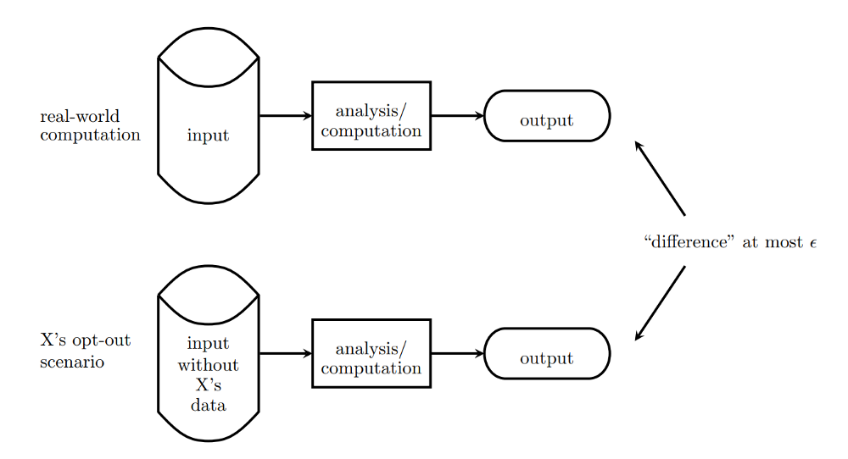
Research Motivation

Slide 5

The Shuffle Model of DP
Centralised Model of DP: users submit sensitive personal information directly to a trusted central data collector.
Local Model of DP: each user applies a local randomiser to add random noise to their data before it is submitted, no need for trusted party.
The (Single-Message) Shuffle Model introduces an additional “shuffling step” to the Local Model:
after the data from each user is encoded, it is randomly permuted to unbind each user from their data before analysis takes place.

Slide 6
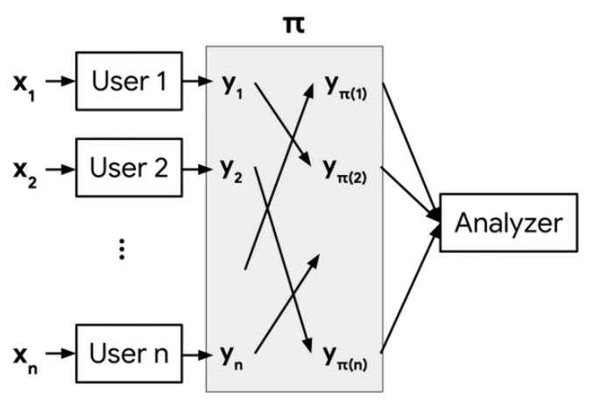
The Shuffle Model of DP

Slide 7
Extending the Shuffle Model to Vectors
Extended “The Privacy Blanket of the Shuffle Model” (Balle et al., 2019) to be applicable to vectors rather than just scalars
Two contributions:
an optimal single message protocol for summation of real vectors in the Shuffle Model,
and an improvement of this bound through implementation of a Discrete Fourier Transform (DFT), which minimises initial error at expense of the loss in accuracy.

Slide 8
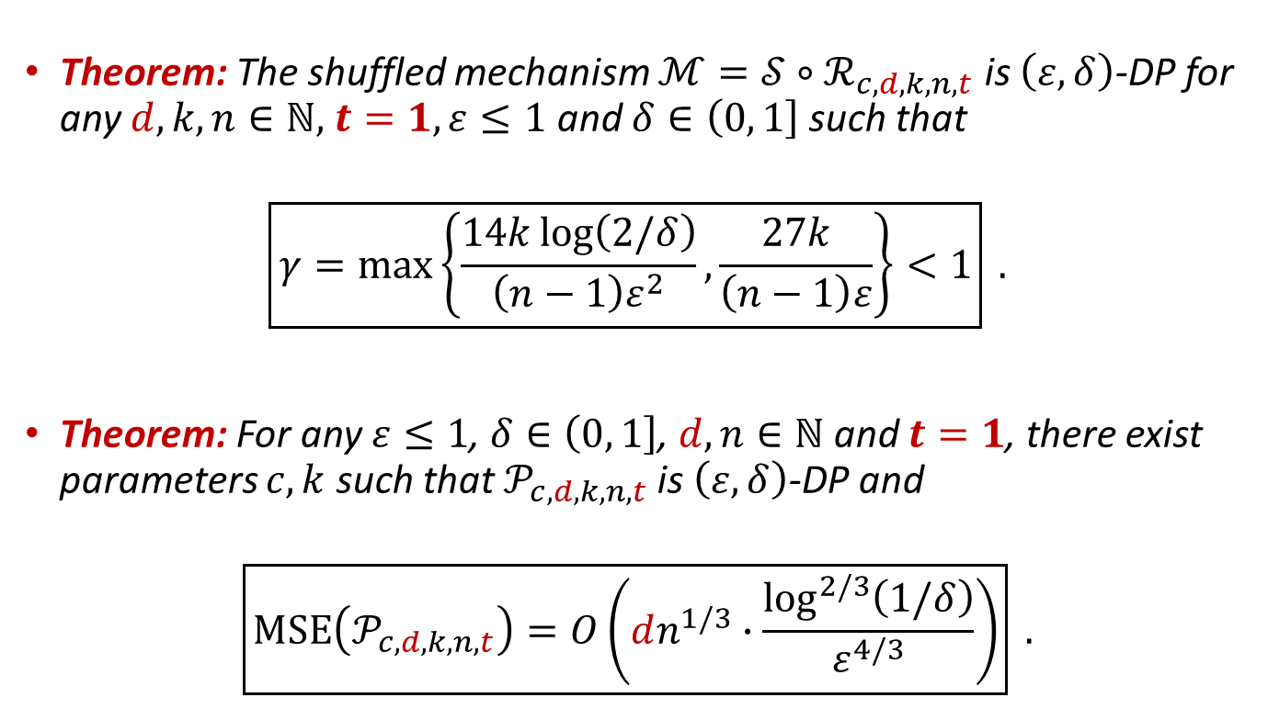
Privacy Analysis of Single-Message Protocol
Theorem: The shuffled mechanism $ℳ=𝒮∘ℛ_{c,d,k,n,t}$ is $\left(ε,δ\right)$-DP for any $d,k,n∈ℕ,$ $t=1,ε≤1$ and $δ∈\left(0,\left.1\right]\right.$ such that
$$\boxed{γ=\max\left\{\frac{14k\log\left(2/δ\right)}{\left(n−1\right)ε^{2}},\frac{27k}{\left(n−1\right)ε}\right\}{<1}} .$$
Theorem: For any $ε≤1$, $δ∈\left(0,\left.1\right]\right.$, $d,n∈ℕ$ and $t=1$, there exist parameters $c,k$ such that $𝒫_{c,d,k,n,t}$ is $\left(ε,δ\right)$-DP and
$$\boxed{MSE\left(𝒫_{c,d,k,n,t}\right)=O\left(dn^{1/3}∙\frac{\log^{2/3}\left(1/δ\right)}{ε^{4/3}}\right)} .$$

Slide 9
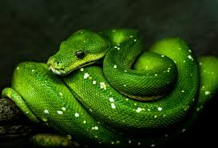
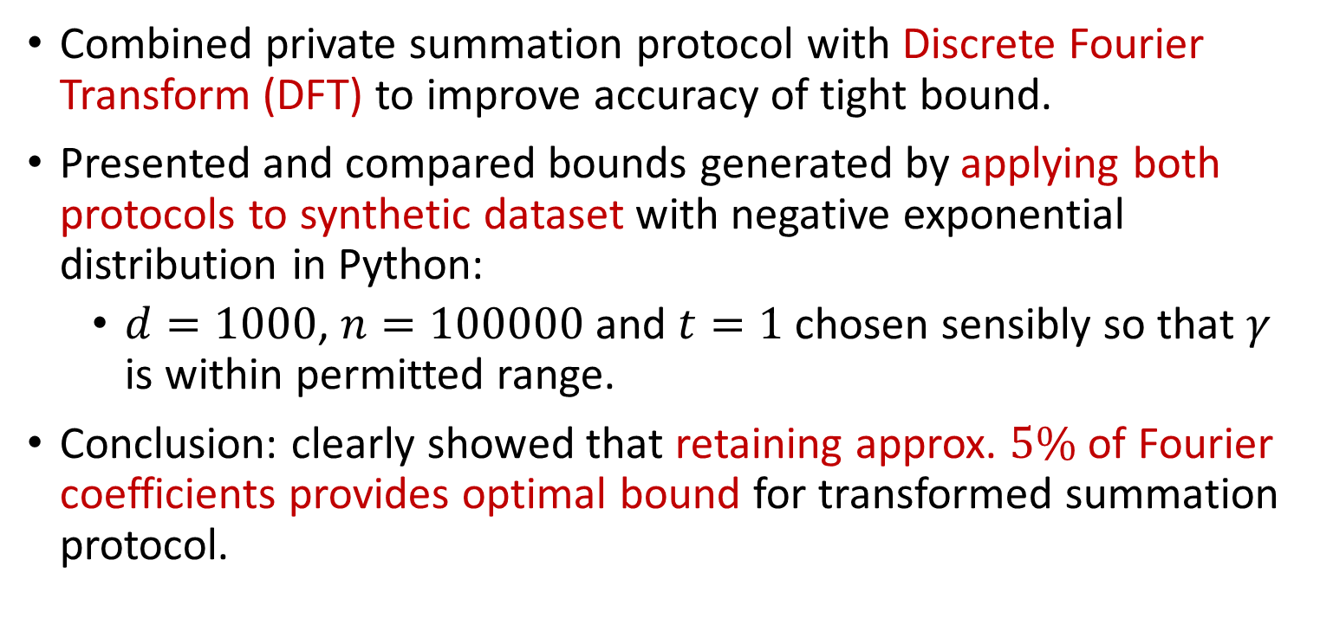
Experimental Evaluation
Combined private summation protocol with Discrete Fourier Transform (DFT) to improve accuracy of tight bound.
Presented and compared bounds generated by applying both protocols to synthetic dataset with negative exponential distribution in Python:
$d=1000$, $n=100000$ and $t=1$ chosen sensibly so that $γ$ is within permitted range.
Conclusion: clearly showed that retaining approx. $5\%$ of Fourier coefficients provides optimal bound for transformed summation protocol.

Slide 10
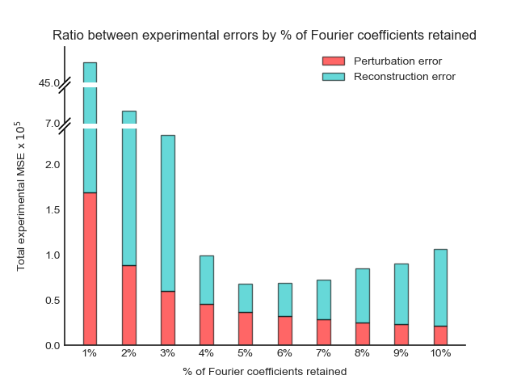
Experimental Evaluation

Slide 11
Thank you for listening ☺
Any questions?

